Slide 1
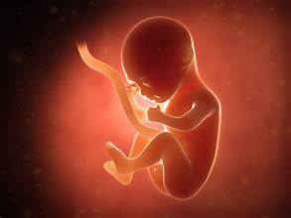
Fetal Health Prediction and Analysis
Using Machine Learning and Data Analysis for Early Detection of Fetal Health Issues
Presented by: SHAMLA FARHA K
Date:6/9/2024

Slide 2
Introduction
The project focuses to evaluate machine learning models for classifying fetal health based on cardiotocogram (CTG) data.
Fetal health monitoring is useful for reducing the maternal and infant mortality.

Slide 3
Project Objectives
The goals of this project are to:
Early detection of fetal health risks
Classification into Normal, Suspect, or Pathological categories
Improve clinical decision-making with data-driven models
The goal is to accurately predict the health status of a fetus as either Normal , Suspect or Pathological, facilitating early detection of potential issues that could lead to maternal or child mortality

Slide 4
Dataset Overview
The Fetal Health Dataset includes:
2,126 records
21 features (including fetal heart rate, accelerations, decelerations , histogram data)
3 target classes: Normal, Suspect, Pathological

Slide 5
Exploratory Data Analysis(EDA)-Data Distribution
Understand the distribution of the data.
Visualizations : Histograms , Box plots , Pie Chart
Insights:
Higher baseline heart rate for pathological cases.

Slide 6
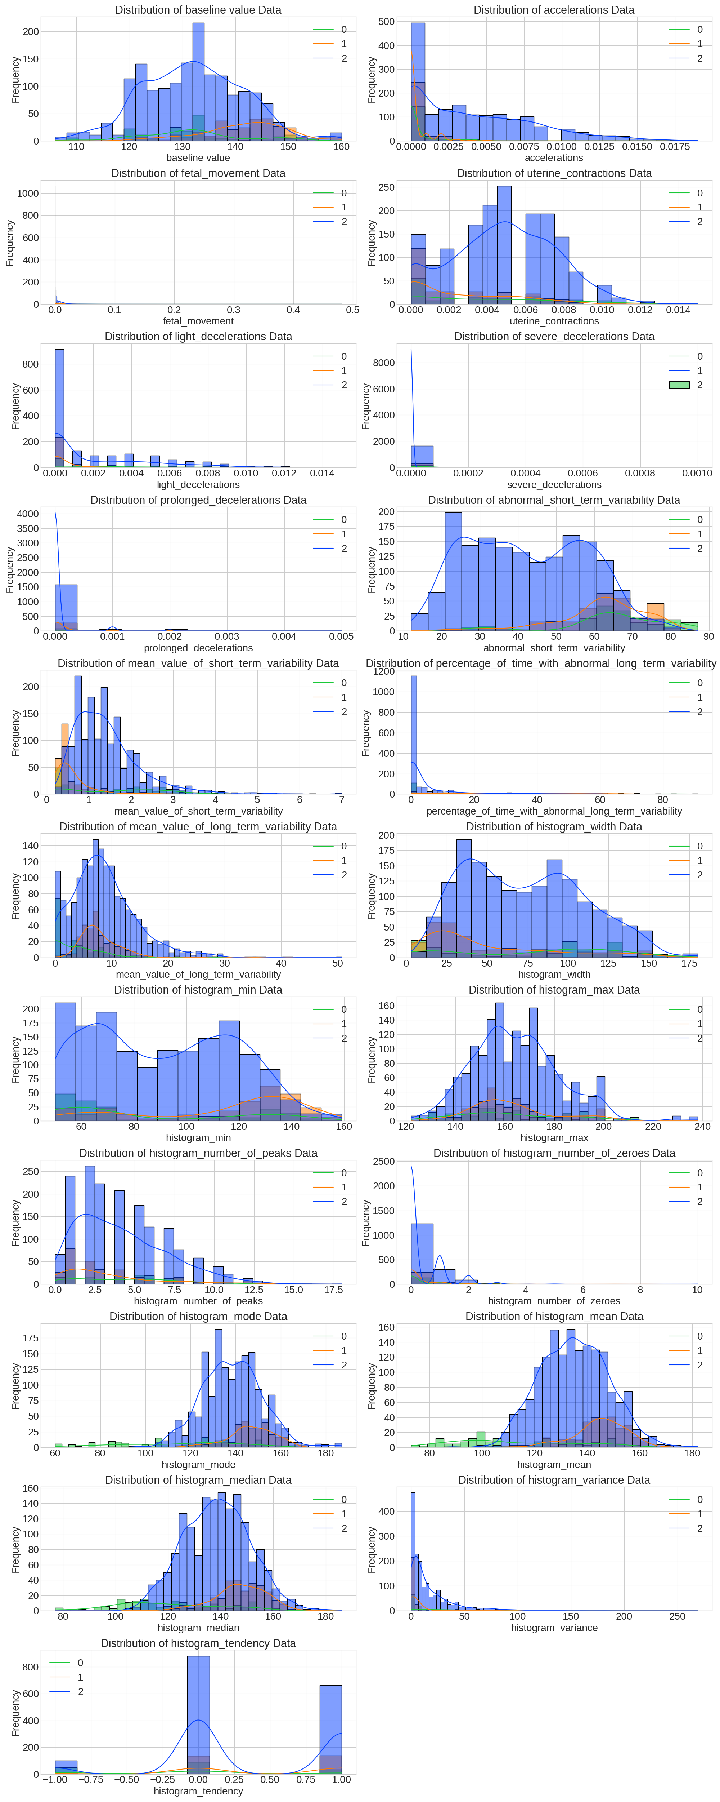
Histogram

Slide 7
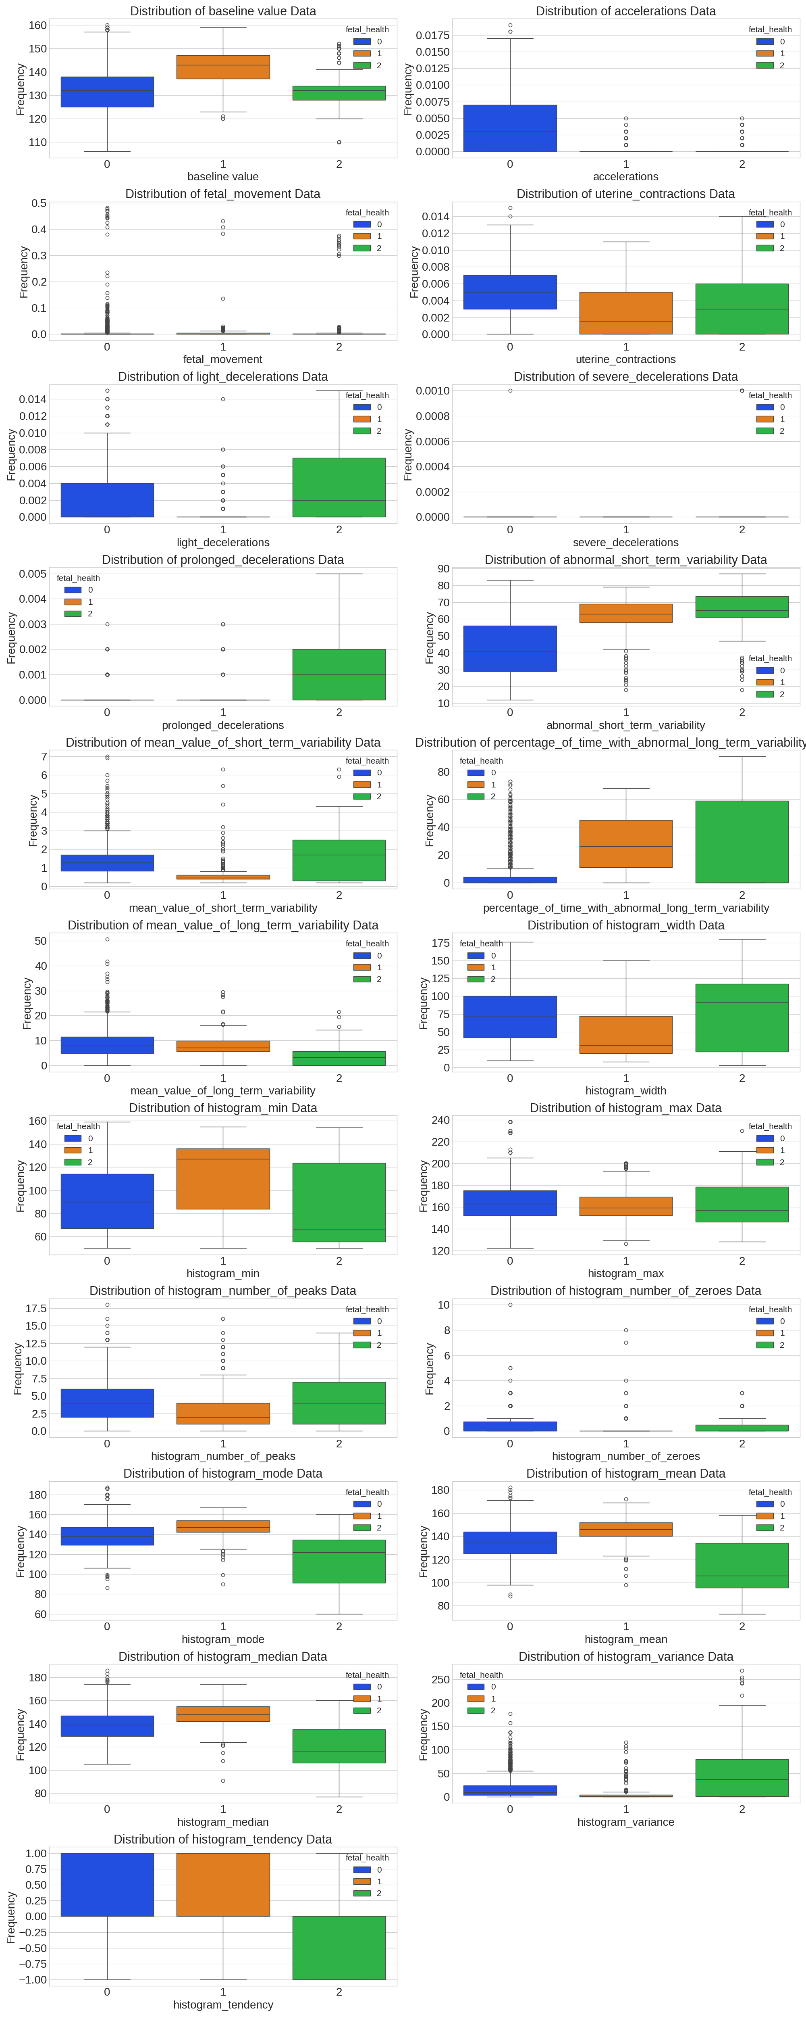
Box plot

Slide 8
EDA-Correlation Analysis
Objectives:
Examine relationships between features.
Content:
Correlation matrix(heatmap) showing correlations between features(accelerations , decelerations , fetal health).
Observations:
High correlation between prolonged decelerations and fetal health.

Slide 9
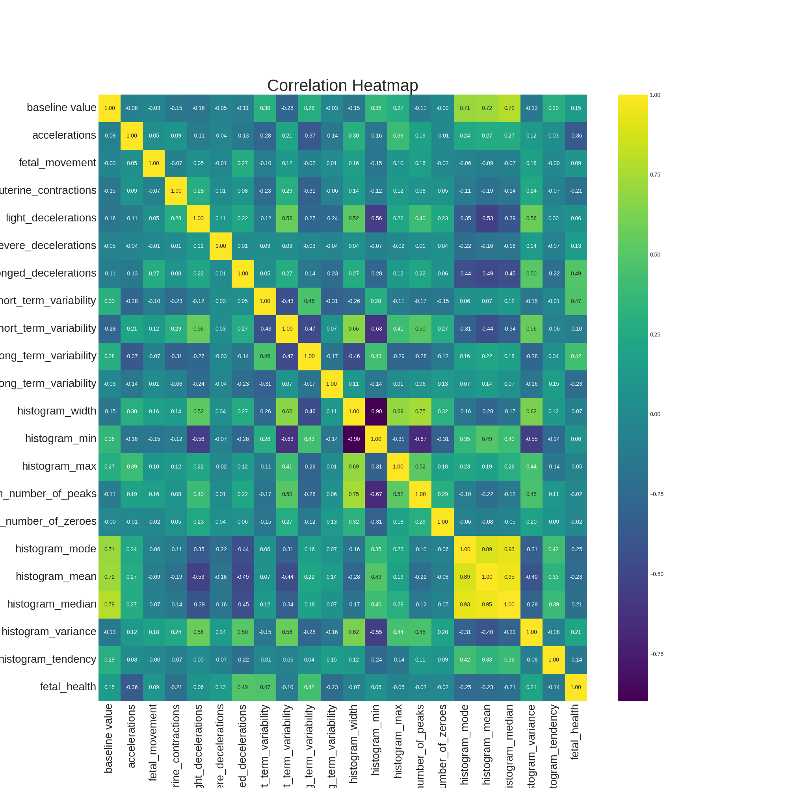
Correlation Heatmap

Slide 10
EDA-Target Variable Distribution
Objectives:
Show the distribution of the target variable(fetal health).
Content:
Bar Chart and Pie Chart showing the proportion of Normal , Suspect , and Pathological cases.
Objectives:
Imbalanced dataset ( more Normal cases than Pathological).

Slide 11
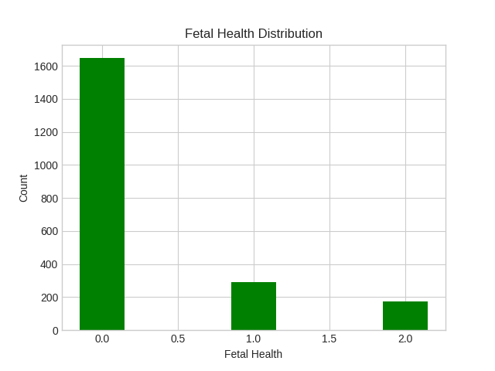

Slide 12
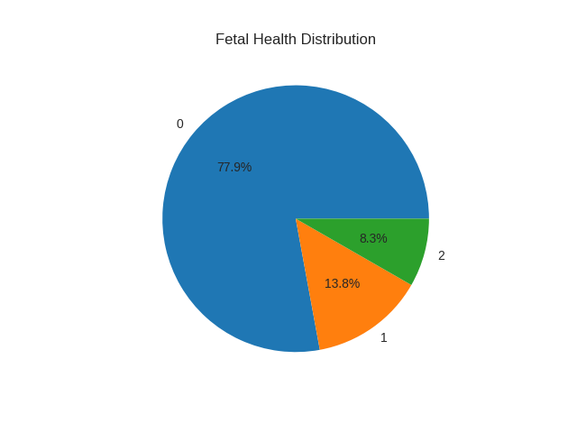

Slide 13
EDA-Feature-Target Relationships
Examine key relationships between features and target.
Content:
Pair plots , Box plots to show relationships between features and target.
Observations:
Trends in heart rate or decelerations based on fetal health class.
Insight:
Early identification of patterns that could influence model development.

Slide 14
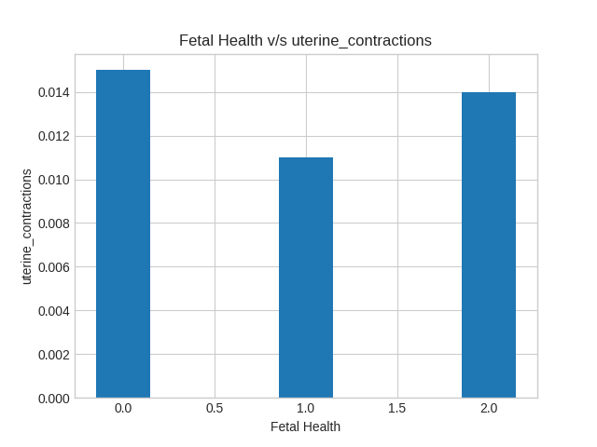

Slide 15
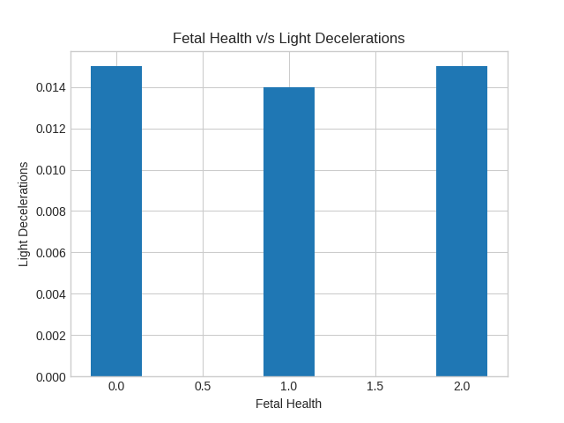

Slide 16
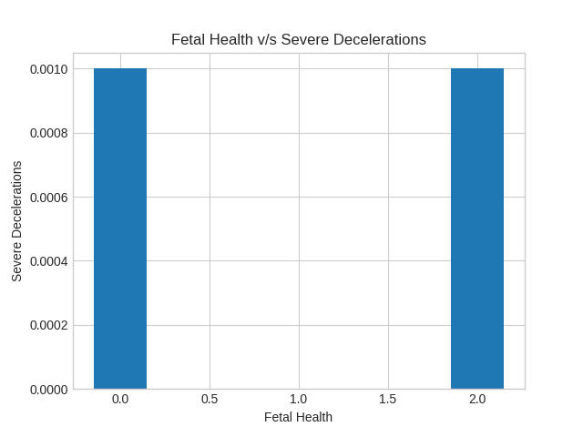

Slide 17
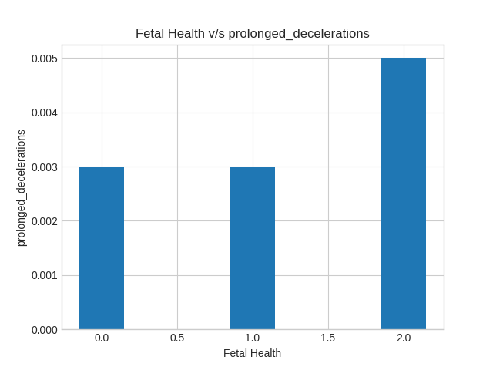

Slide 18
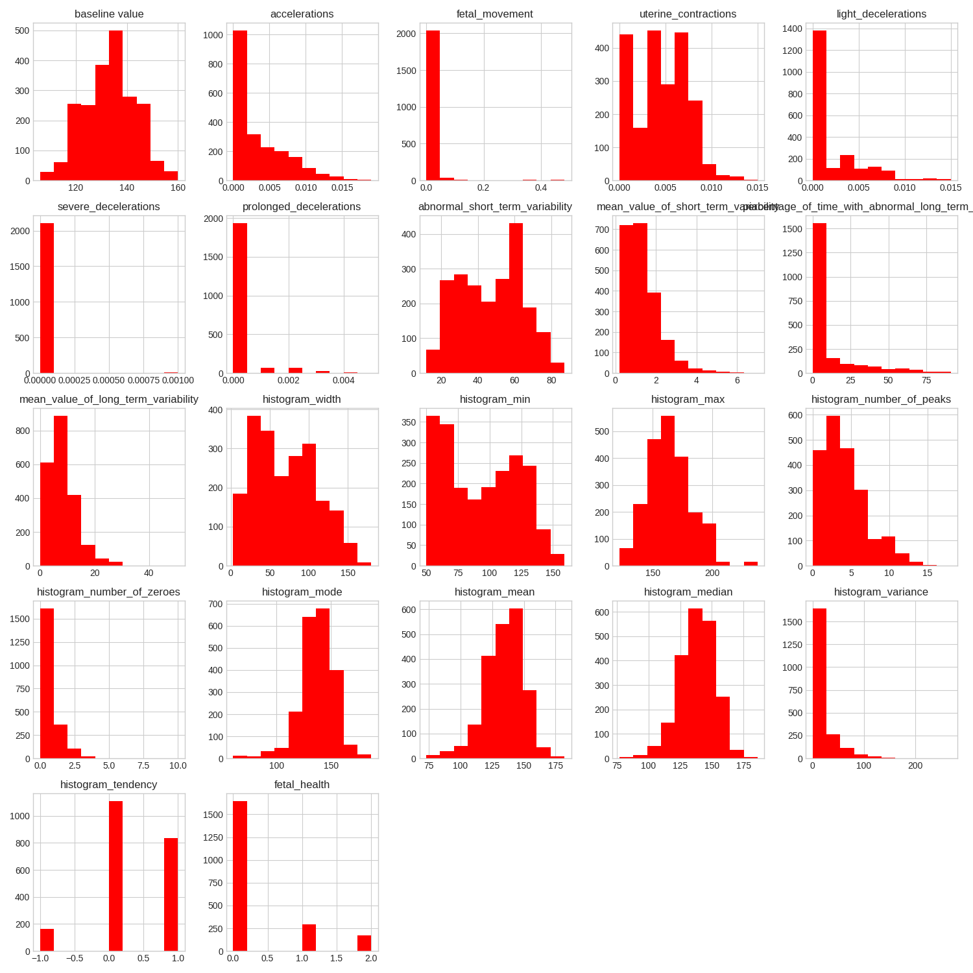

Slide 19
Data Preprocessing
Content:
Handling missing values.
Handling duplicate values.
Feature scaling.
Handling imbalanced class by SMOTE.
Data was split into training (80%) and testing (20%) sets.

Slide 20
Machine Learning Models
Machine Learning Models Used:
Logistic Regression
Decision Tree Classifier
Random Forest Classifier
AdaBoost Classifier
Gradient Boost Classifier
XG Boost Classifier
K-Nearest Neighbor(KNN)
Support Vector Machine (SVM)

Slide 21
Model Evaluation Metrics
Accuracy
Confusion matrix

Slide 22
Results
The XG Boost Classifier model achieved the highest accuracy.
Accuracy: 98.68%
Visualization: Accuracy comparison between models, confusion matrix for best model.

Slide 23
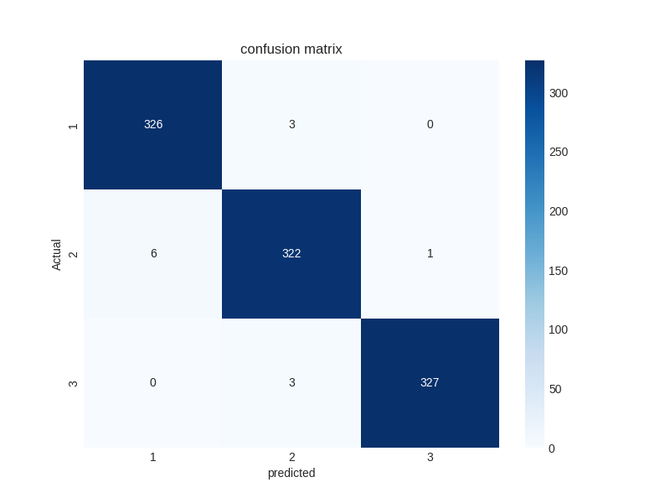
Confusion Matrix

Slide 24
Challenges and Future Work
Challenges:
Small dataset size
Imbalanced classes
Possible data biases
Future Work:
Larger datasets for improved accuracy
Integration with real-time fetal monitoring

Slide 25
Conclusion
This project demonstrates how machine learning can enhance fetal health monitoring.
With early detection, it is possible to reduce infant and maternal mortality.

Slide 26
Questions & Answers
Questions?

Slide 27
t
THANK YOU

